Slide 1
Switching and Forwarding
Slides adapted from Larry Peterson
Outline
  Store-and-Forward Switches
  Bridges and Extended LANs
Reading:
Chapter 3: 3.1
FTP
HTTP
NV
TFTP
TCP
UDP
IP
NET
NET
■ ■ ■
NET
1
2
n
MU CS4850/7850
Notes:
Not all networks/nodes are directly connected.

Slide 2
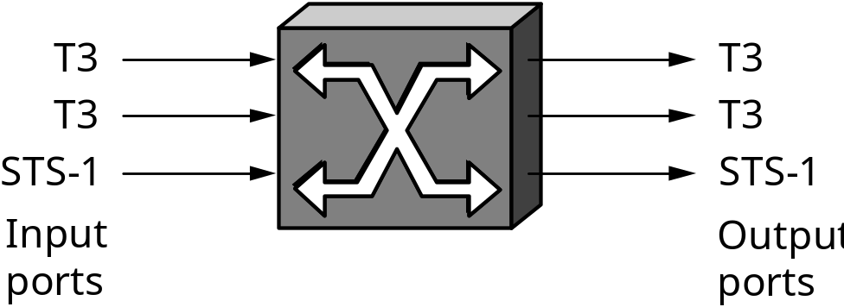
Scalable Networks
Switch
  forwards packets from input port to output port
  port selected based on address in packet header
Advantages
  cover large geographic area (tolerate latency)
  support large numbers of hosts (scalable bandwidth)
Three approaches
MU CS4850/7850

Slide 3
Switching Approaches
Source Routing
Virtual Circuit Switching
Datagram Switching
MU CS4850/7850

Slide 4
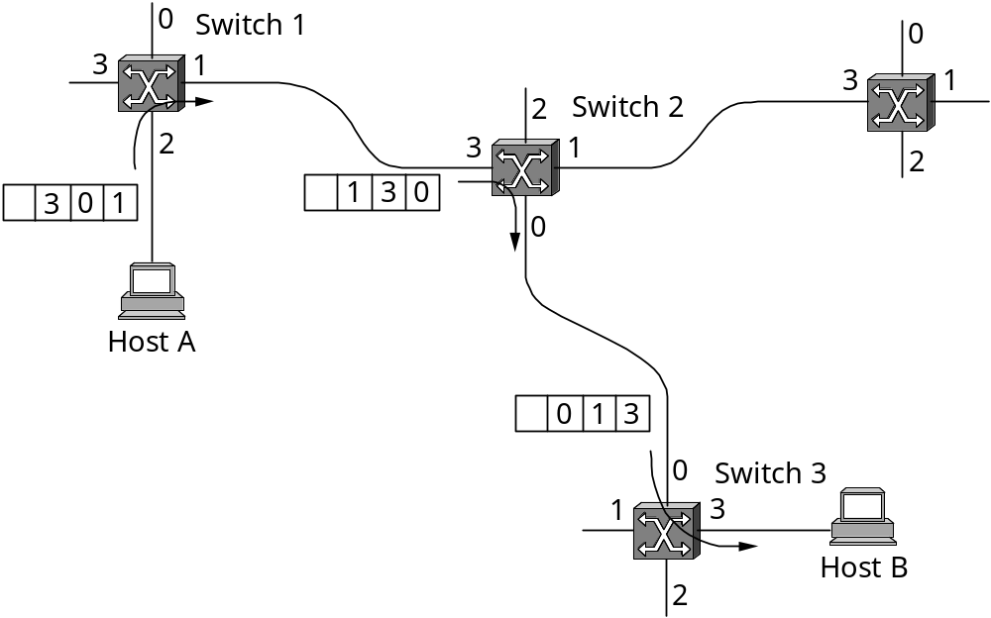
Source Routing
Source constructs header
Knows network topology
Variable length header
Suffer from scaling problem
MU CS4850/7850

Slide 5
Virtual Circuit Switching
Explicit connection setup (and tear-down) phase
Subsequent packets follow same circuit
Sometimes called connection-oriented model
0
0
0
3
1
3
1
11
3
1
Switch 1
Switch 2
2
2
2
Analogy: phone call
Each switch maintains a VC table
5
7
0
Switch 3
3
1
Host A
4
Host B
2
Permanent VC vs “Signaled” VC
Setup message + ack message
Teardown message
MU CS4850/7850
Notes:
VCI has a link local scope. The combination of the VCI of packets and the interface on which they are received uniquely identifies the virtual connection.

Slide 6
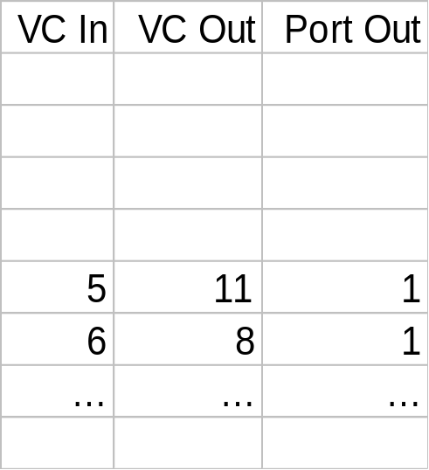
Example Tables
0
0
0
1
Circuit Table
(switch 1, port 2)
3
3
1
11
3
1
Switch 1
Switch 2
2
2
2
5
7
0
Switch 3
3
1
Host A
4
Host B
2
VCI has a link local scope
  Different connection has a different VCI on the same link
In setup process, switch assigns VC In, which is later conveyed to uplink switch in ACK message
MU CS4850/7850

Slide 7
0
0
0
3
1
3
1
11
3
1
Switch 1
Switch 2
2
2
2
5
7
0
Switch 3
3
1
Host A
4
Host B
2
Switch/Host | In port | VCI in | Out port | VCI out
Host A
SW1
SW2
SW3
Host B
MU CS4850/7850

Slide 8
Virtual Circuit Model
Typically wait full RTT for connection setup before sending first data packet.
While the connection request contains the full address for destination, each data packet contains only a small identifier, making the per-packet header overhead small.
If a switch or a link in a connection fails, the connection is broken and a new one needs to be established. Old one will be torn down.
Connection setup provides an opportunity to reserve resources (e.g., buffers).
Examples: Frame Relay and ATM
MU CS4850/7850
Notes:
Permanent VC vs. Switched/signaled virtual circuit (SVC) using a setup message and its ACK
Teardown message would delete related entries in the switches..

Slide 9
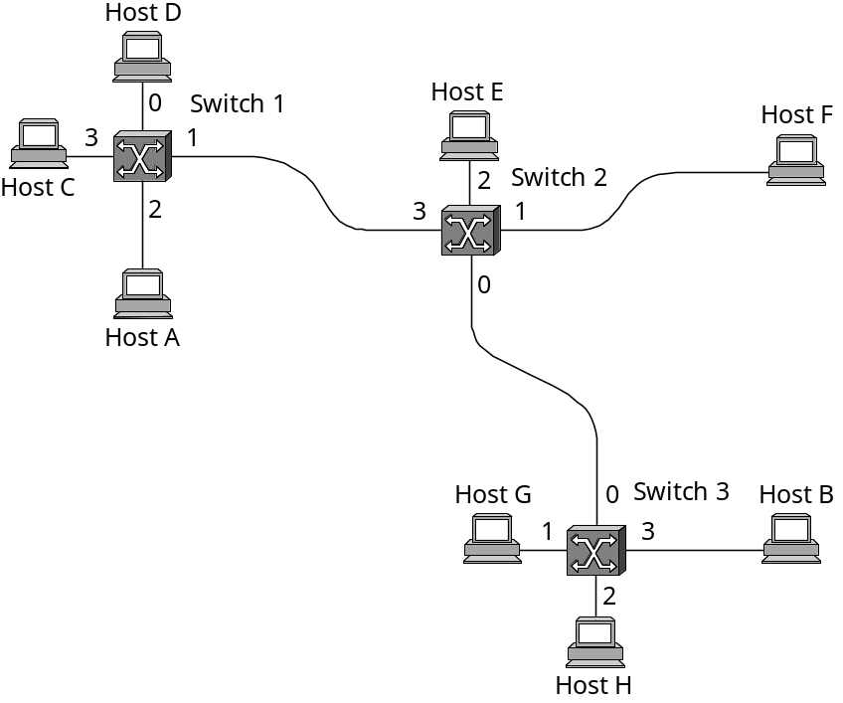
Datagram Switching
No connection setup phase
Each packet forwarded independently
Sometimes called connectionless model
Analogy: postal system
Each switch maintains a forwarding (routing) table
Routing is a harder problem
MU CS4850/7850
Notes:
Forwarding table generated through routing process.

Slide 10
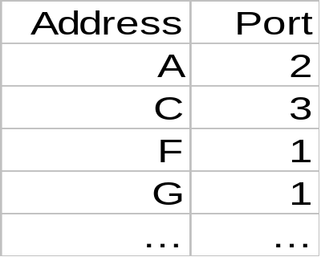
Example Tables
Forwarding Table
(switch 1)
MU CS4850/7850

Slide 11
Datagram Model
There is no round trip delay waiting for connection setup; a host can send data as soon as it is ready.
Source host has no way of knowing if the network is capable of delivering a packet or if the destination host is even up.
Since packets are treated independently, it is possible to route around link and node failures.
Since every packet must carry the full address of the destination, the overhead per packet is higher than for the connection-oriented model.
MU CS4850/7850

Slide 12
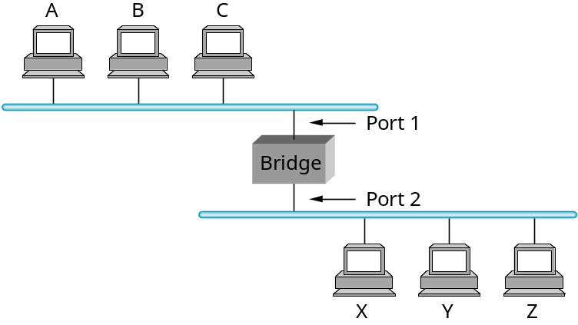
Bridges and Extended LANs
LANs have physical limitations (e.g., 2500m)
Connect two or more LANs with a bridge
  accept and forward frame strategy
  level 2 (link layer) connection (does not add packet header)
MU CS4850/7850
Notes:
Steroids? any of numerous compounds

Slide 13
Bridges: Traffic Isolation
Bridge installation breaks LAN into LAN segments
bridges filter packets:
  same-LAN-segment frames not usually forwarded onto other LAN segments
  when frame is to be forwarded, uses CSMA/CD to access segment
  segments become separate collision domains
collision
domain
collision
domain
= hub
bridge
= host
LAN segment
LAN segment
Extended LAN
MU CS4850/7850

Slide 14
Learning Bridges
Do not forward when unnecessary
  based on MAC dest address
Maintain forwarding table
Host Port
A 1
B 1
C 1
X 2
Y 2
Z 2
Plug-and-play, self-learning
  bridges do not need to be configured
  learn table entries based on MAC source address
Always forward broadcast frames
MU CS4850/7850

Slide 15
Learning Bridges
Spring 2016
CMP_SC 4850/7850
How to build routing table
  Each bridge inspects the source address in all the frames it receives
  Record the information at the bridge and build the table
  When a bridge first boots, this table is empty
  Entries are added over time
  A timeout is associated with each entry
  The bridge discards the entry after a specified period of time
    To protect against the situation in which a host is moved from one network to another
If the bridge receives a frame that is addressed to host not currently in the table
  Forward the frame out on all other ports

Slide 16
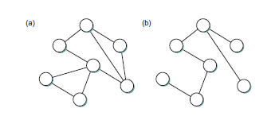
Spanning Tree
Spring 2016
CMP_SC 4850/7850
What may be some potential problems with the learning approach on the previous slide?
  Loops
Solution?
  Spanning tree

Slide 17
Limitations of Bridges
Do not scale
  spanning tree algorithm (to break loop) does not scale
  broadcast does not scale
Do not accommodate heterogeneity
  Bridges make use of frame header
Caution: beware of transparency
  Packet dropping, delay, out of order delivery
MU CS4850/7850

